Slide 2
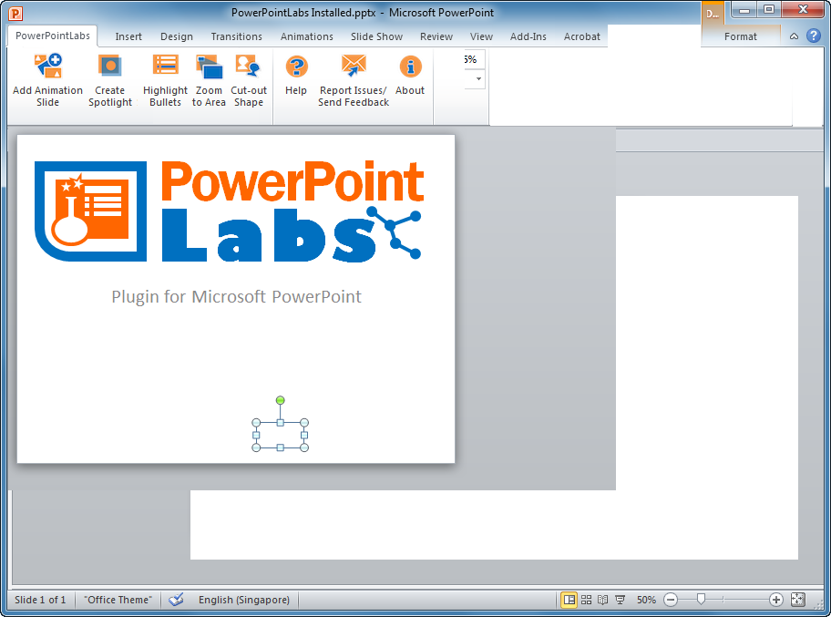
PowerPointLabs

